Slide 1
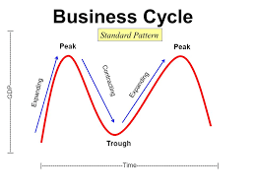
Business Cycle/Trade Cycle

Slide 2
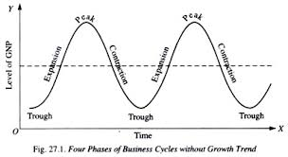
Meaning
The Business cycle is upward and downward of economic activity, going one after another in a cyclical way. It is associated with sweeping fluctuations in economic activities such as production, prices, income, employment, exports, imports, etc.

Slide 3
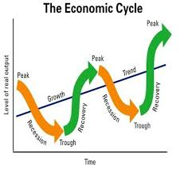
Definition
“ A Business Cycle is composed of a period of good trade characterized by rising prices and low unemployment percentage, alternating with a period of bad trade characterized by falling prices and high unemployment percentage”.
- Keynes

Slide 4
Features/Characteristics
It occurs periodically – The prosperity and depression will be occurring alternatively.
It is all embracing – Affects all industries in the entire economy.
It is wave-like – it will have a set pattern of movements which is analogous to waves.
The process is cumulative and self-reinforcing – the upward and downward movements are cumulative in their process.
The cycles will be similar but not identical – different cycles and waves in the business cycles will be similar but not identical.

Slide 5
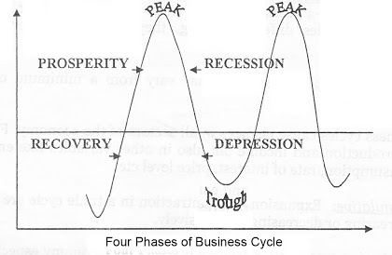
Phases of Business Cycle

Slide 6

1. Prosperity Phase
High level of output and trade.
High level of effective demand.
High level of income and employment.
Rising interest rates.
Inflation.
Large expansion of bank credit.
Overall business optimism.
A high level of MEC (Marginal efficiency of capital) and investment.

Slide 7

2. Recession Phase
During a recession period, the economic activities slow down. There is a steady decline in the output, income, employment, prices and profits.
The businessmen lose confidence and become pessimistic.
It reduces investment.

Slide 8

3. Depression Phase
Fall in volume of output and trade.
Fall in income and rise in unemployment.
Decline in consumption and demand.
Fall in interest rate.
Deflation.
Contraction of bank credit.
Overall business pessimism.
Fall in MEC (Marginal efficiency of capital) and investment.

Slide 9
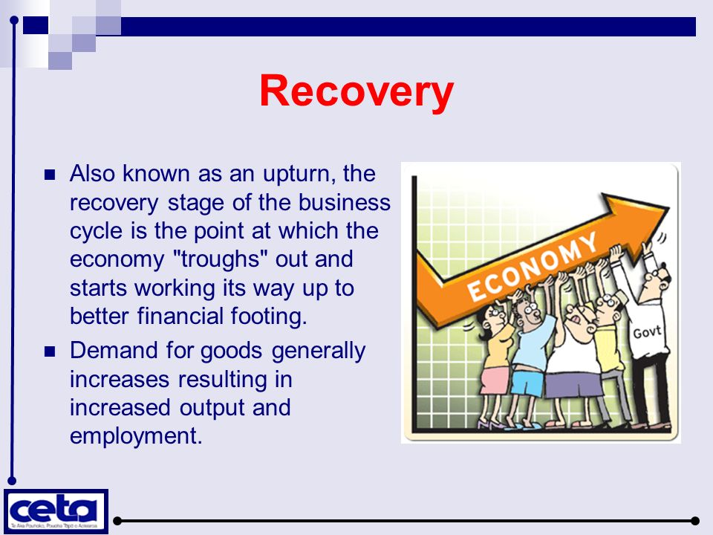
4. Recovery Phase
During the period of revival or recovery, there are expansions and rise in economic activities.
When demand starts rising, production increases and this causes an increase in investment.
There is a steady rise in output, income, employment, prices and profits.
The businessmen gain confidence and become optimistic (Positive). This increases investments.

Slide 10
Theories of Business Cycle
Sun-Spot Theory
Sun-spot theory was developed in 1875 by Stanley Jevons. Sun-spots are storms on the surface of the sun caused by violent nuclear explosions there.
Since econo­mies in the olden world were heavily dependent on agriculture, changes in climatic conditions due to sun-spots produced fluctuations in agricultural output.
Changes in agricultural output through its demand and input-output relations affect industry. Thus, swings in agricultural output spread throughout the economy.

Slide 11
2. Hawtrey’s Monetary Theory of Business Cycles
economy is said be under gold standard when either money in circulation consists of gold coins or when paper notes are fully backed by gold reserves in the banking system.
According to Hawtrey, increases in the quantity of money raises the availability of bank credit for investment. Thus, by increasing the supply of credit expansion in money supply causes rate of interest to fall. The lower rate of interest induces businessmen to borrow more for investment in capital goods and also for investment in keeping more inventories of goods.

Slide 12
3. Over-Investment Theory:
It has been observed that over time investment varies more than that of total output of final goods and services and consumption. This has led economists to investigate the causes of variation in investment and how it is responsible for business cycles.
Two versions of over-in­vestment theory have been put forward. One theory offered by Hayek emphasises monetary forces in causing fluctuations in investment. The second version of over-investment theory has been developed by Knut Wickshell which emphasises spurts of investment brought about by innovation.

Slide 13
4. Schumpeter’s Theory of Innovation
The Schumpeter’s theory of innovation advocates that business innovations are responsible for rapid changes in investment and business fluctuations.
According to Schumpeter, innovation refers to an application of a new technique of production or new machinery or a new concept to reduce cost and increase profit. In addition, he propounded that innovations are responsible for the occurrence of business cycles.

Slide 14
5. Keynes Theory
In his theory of business cycles, Keynes advocated that the total demand helps in the determination of various economic factors, such as income, employment, and output. The total demand refers to the demand of consumer and capital goods.
Therefore, changes in income and output level are produced by changes in total demand. The total demand is further affected by changes in the demand of investment, which depends on the rate of interest and expected rate of profit.

